Slide 1
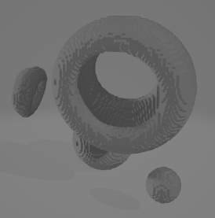
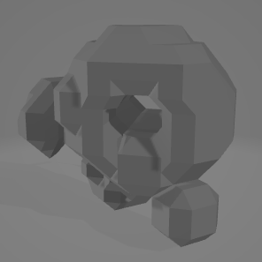

Slide 2
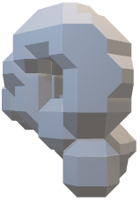
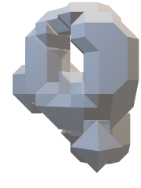
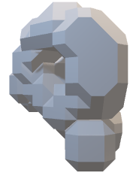
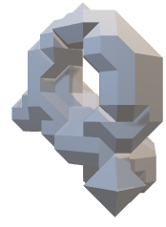
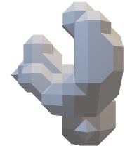
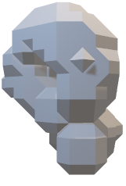
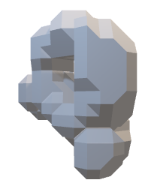
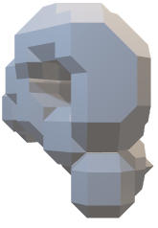
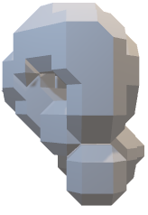
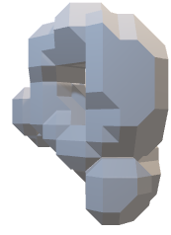
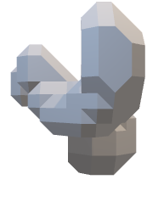
t₀ | t₁ | t₂ | t₃ | t₄ | t₅ | t₆ | t₇ | t₈ | t₁₀
All time-points
T=8
Reduced length after cropping 1 at the beginning and end
t₁ | t₂ | t₃ | t₄ | t₅ | t₆ | t₇ | t₈
TINC=2
TINC=2
TINC=2
After incrementing
t₁ |  | t₃ |  | t₅ |  | t₇
3 extracted samples for single frame input model
1 extracted sample for multiple frame input model
t₁ | t₃
t₀ | t₁
t₃ | t₅
t₀ | t₁
t₅ | t₇
t₀ | t₁
t₁ | t₃ | t₅ | t₇
t₋₂ | t₋₁ | t₀ | t₁
input
target
input
target
input
target
input
target

Slide 3
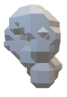
t₀ | t₁ | t₂ | t₃ | t₄ | t₅ | t₆ | t₇ | t₈ | t₁₀
All time-points
T=8
Reduced length after cropping 1 at the beginning and end
t₁ | t₂ | t₃ | t₄ | t₅ | t₆ | t₇ | t₈
TINC=2
TINC=2
TINC=2
After incrementing
t₁ |  | t₃ |  | t₅ |  | t₇
t₁ | t₃ | t₅
t₀ | t₁ | t₂
t₃ | t₅ | t₇
t₁ | t₂ | t₃
Input sequence
Target sequence
1 extracted sample with a pair of input and output sequences

Slide 4

ENCODER
Encoder Input Object at t₋₂, t₋₁ or t₀ (size=16x16x16x1)
Conv3D(filters=32, kernel_sizes=5, strides=1)
Batch Normalization
LeakyReLU
Dropout
Conv3D(filters=64, kernel_sizes=5, strides=2)
Batch Normalization
LeakyReLU
Dropout
Conv3D(filters=128, kernel_sizes=5, strides=2)
Batch Normalization
LeakyReLU
Dropout
Conv3D(filters=256, kernel_sizes=5, strides=1)
Batch Normalization
LeakyReLU
Dropout
Flatten
Dense(units=256 or 3x256, activation=None)
Encoded Object (units=256 or 3x256)

Slide 5
Encoded Object(s) (units=256 or 3x256)
GENERATOR
Dense (units=((256 or 3x256)*4*4*4=16384 or 49152)
Reshape (shape=4x4x4x256)
Batch Normalization
ReLU
Conv3DTranspose(filters=128, kernel_sizes=5, strides=1)
Batch Normalization
ReLU
UpSampling3D(size=2)
Conv3DTranspose(filters=64, kernel_sizes=5, strides=1)
Batch Normalization
ReLU
UpSampling3D(size=2)
Conv3DTranspose(filters=32, kernel_sizes=5, strides=1)
Batch Normalization
ReLU
Conv3DTranspose(filters=1, kernel_sizes=5, strides=1)
Sigmoid Activation
Generator Output Object (size=16x16x16x1)

Slide 6
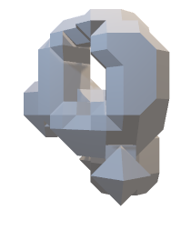

DISCRIMINATOR
Conditional Input Object at t₁ (size=16x16x16x1)
Target or Generator Object at t₁ (size=16x16x16x1)
or
Concatenate
Conv3D(filters=32, kernel_sizes=5, strides=1)
LayerNormalization
LeakyReLU
Dropout
Conv3D(filters=64, kernel_sizes=5, strides=2)
LayerNormalization
LeakyReLU
Dropout
Conv3D(filters=128, kernel_sizes=5, strides=2)
LayerNormalization
LeakyReLU
Dropout
Conv3D(filters=256, kernel_sizes=5, strides=1)
LayerNormalization
LeakyReLU
Dropout
Flatten
Dense(units=1, activation=None)
Discriminator Output (units=1)

Slide 7
Target Input Object at t₁
Concatenate Target + Conditional Input Object at t₁ (=2x Target Object as Input to Discriminator)
Discriminator
Network
Conditional Input Object at t₁ (= Target Object at t1)
WGAN GP LOSS
Input Object at t₀
AE
Convolutional Network
Encoded Object to vector of size 256
Generator
Network
Generated Object at t₁
Discriminator
Network
Latent Vector
Concatenate Generated + Conditional Input Object at t1
Target Input Object at t₁
Concatenate Target + Conditional Input Object at t₁ (=2x Target Object as Input to Discriminator)
Discriminator
Network
Input Object at t₋₂
AE
Convolutional Network
Conditional Input Object at t₁ (= Target Object at t1)
Encoded Object to vector of size 3x256
WGAN GP LOSS
Input Object at t₋₁
Latent Vector
Generator
Network
Generated Object at t₁
Discriminator
Network
Shared Weights Auto Encoder
Concatenate
Concatenate Generated + Conditional Input Object at t1
Input Object at t₀

Slide 8
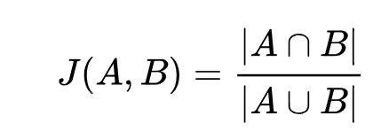

Slide 9
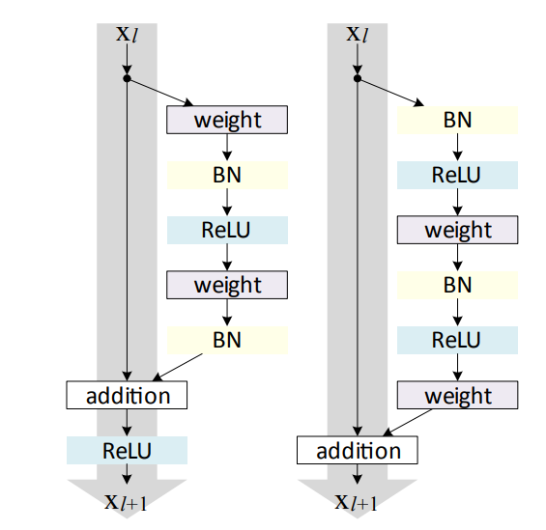
a)
b)
c)

Slide 10
ConvLSTM
Input Frames of Objects t₀, t₁, …, t_{N-2} (size=(N-1)x16x16x16x1)
t₀ … t_{N-2}
ConvLSTM3D(filters=32, kernel_sizes=5)
ReLU
Batch Normalization
ConvLSTM3D(filters=32, kernel_sizes=3)
ReLU
Batch Normalization
ConvLSTM3D(filters=32, kernel_sizes=1)
ReLU
Conv3D(filters=1, kernel_sizes=5)
Sigmoid Activation
Output Frames of Objects t₁, t₂, …, t_{N-1} (size=(N-1)x16x16x16x1)
t₁ … t_{N-1}

Slide 11
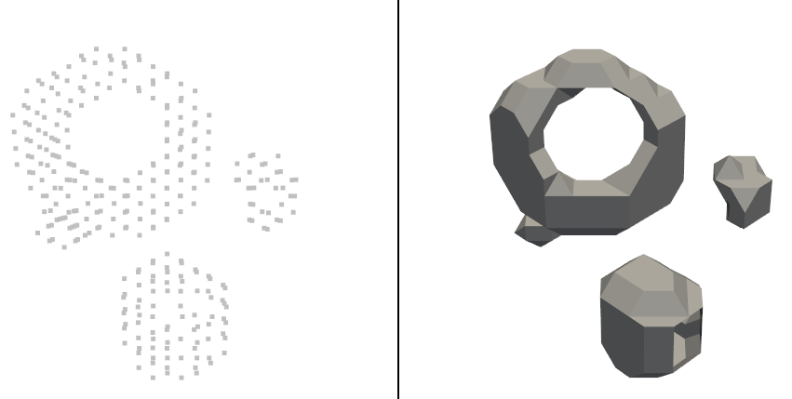
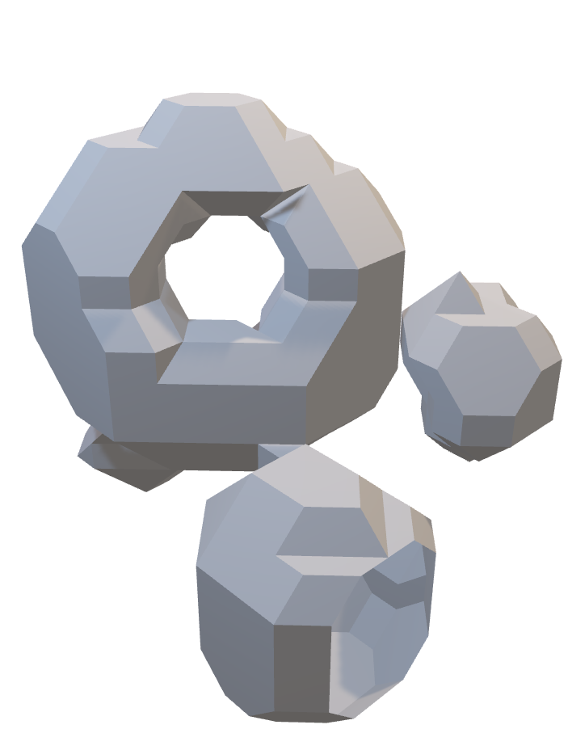

Slide 12
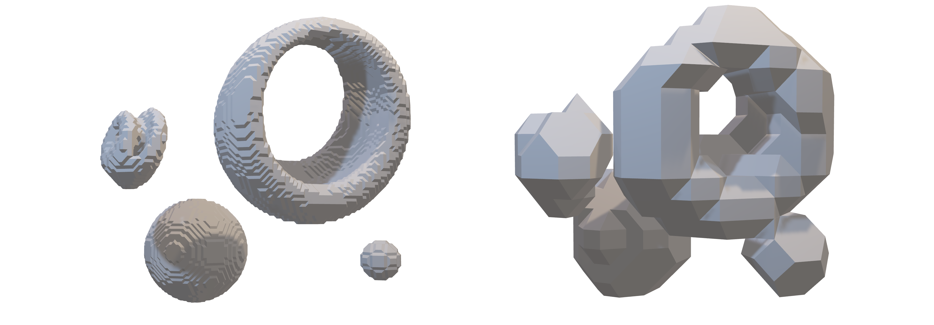
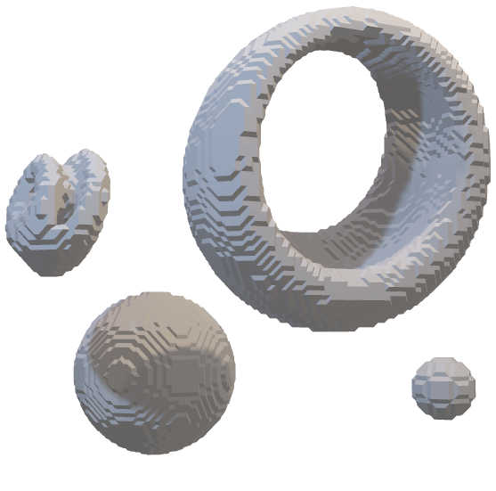
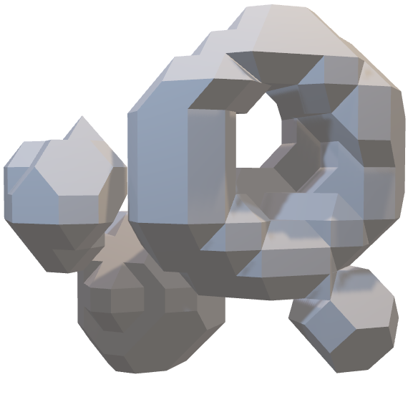

Slide 13
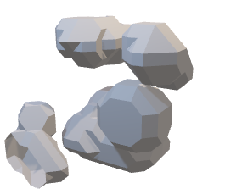
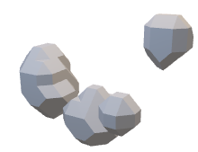
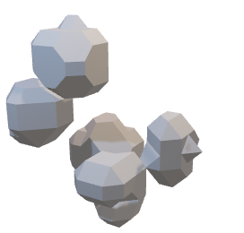
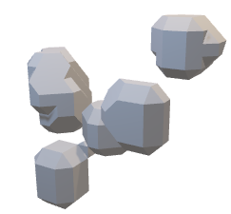
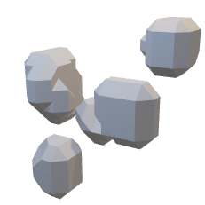
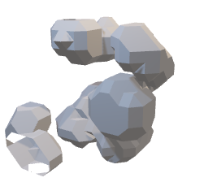
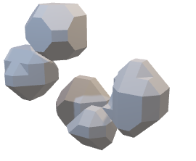
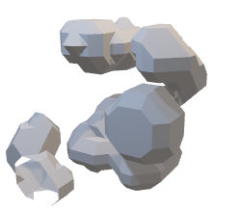
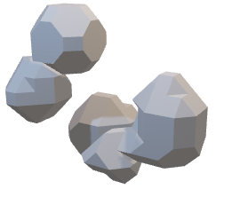
Single Frame Input Model
T20 TINC1
T40 TINC2
T80 TINC4
t_{1,target}
t_{1,target}
t_{1,target}
t_{0,input}
t_{0,input}
t_{0, input}
t_{1,prediction}
t_{1,prediction}
t_{1,prediction}

Slide 14
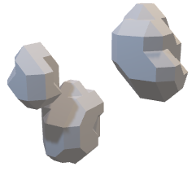
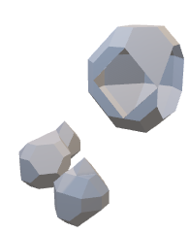
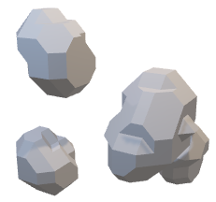
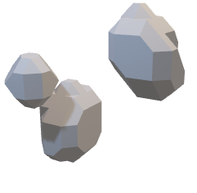
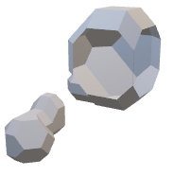
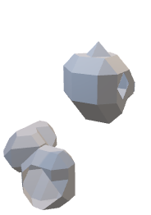
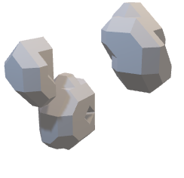
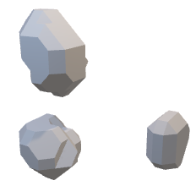
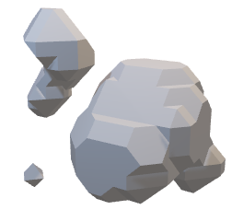
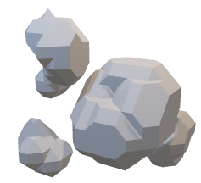
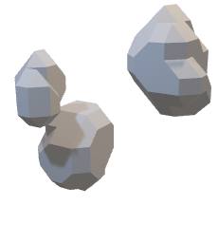
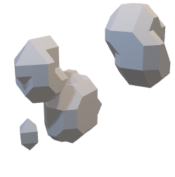
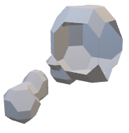
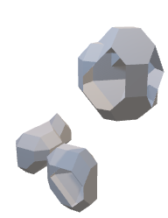
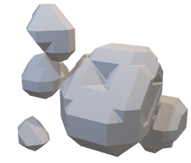
Multiple Frame Input Model
T20 TINC1
T40 TINC2
T80 TINC4
t_{-2,input}
t_{-2,input}
t_{-2,input}
t_{1,target}
t_{1,target}
t_{1,target}
t_{-1,input}
t_{-1,input}
t_{-1,input}
t_{1,prediction}
t_{1,prediction}
t_{1,prediction}
t_{0,input}
t_{0,input}
t_{0,input}

Slide 15
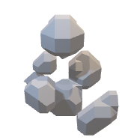
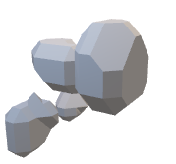
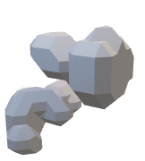
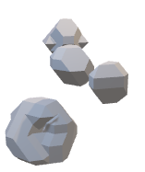




























ConvLSTM Model
t₀
t₁
t₂
t₃
t₄
t₅
_{Input/Target}
T20 TINC1
t₁
t₂
t₃
t₄
t₅
_{Prediction}
t₀
t₁
t₂
t₃
t₄
t₅
_{Input/Target}
T40 TINC2
t₁
t₂
t₃
t₄
t₅
_{Prediction}
t₀
t₁
t₂
t₃
t₄
t₅
_{Input/Target}
T80 TINC4
t₂
t₃
t₄
t₅
t₁
_{Prediction}

Slide 16
































Single Frame Input Model
_{Target}
t₁
t₂
t₃
t₄
t₅
t₀
_{Input}
T20 TINC1
t₁
t₂
t₃
t₄
t₅
_{Prediction}
_{Target}
t₁
t₂
t₃
t₄
t₅
t₀
_{Input}
T40 TINC2
t₁
t₂
t₃
t₄
t₅
_{Prediction}
_{Target}
t₁
t₂
t₃
t₄
t₅
t₀
_{Input}
T80 TINC4
t₁
t₂
t₃
t₄
t₅
_{Prediction}

Slide 17







































_{Input}
Multiple Frame Input Model
t₋₂
t₁
t₂
t₃
t₄
t₅
_{Target}
t₋₁
T20 TINC1
t₁
t₂
t₃
t₄
t₅
t₀
_{Prediction}
t₋₂
t₁
t₂
t₃
t₄
t₅
_{Target}
t₋₁
T40 TINC2
t₁
t₂
t₃
t₄
t₅
t₀
_{Prediction}
t₋₂
t₁
t₂
t₃
t₄
t₅
_{Target}
t₋₁
T80 TINC4
t₁
t₂
t₃
t₄
t₅
t₀
_{Prediction}

Slide 18












































ConvLSTM Model
_{Target}
t₂
t₃
t₄
t₅
t₁
t₋₄
t₋₃
t₋₂
t₋₁
t₀
T20 TINC1
t₁
t₂
t₃
t₄
t₅
_{Input}
_{Prediction}
_{Target}
t₂
t₃
t₄
t₅
t₁
t₋₄
t₋₃
t₋₂
t₋₁
t₀
T40 TINC2
t₁
t₂
t₃
t₄
t₅
_{Input}
_{Prediction}
_{Target}
t₂
t₃
t₄
t₅
t₁
t₋₄
t₋₃
t₋₂
t₋₁
t₀
T80 TINC4
t₁
t₂
t₃
t₄
t₅
_{Input}
_{Prediction}

Slide 19



